Slide 1
Cumbria Innovation Workshop Cumbria Innovation Research April 2022 Stephen Nicol of Nicol Economics
Notes:
I am sharing some findings from a recent productivity “deep dive” carried out for Cumbria LEP
This is based on work looking at economic data for Cumbria and its business sector supplemented by wider research at a UK, North West and local level

Slide 2
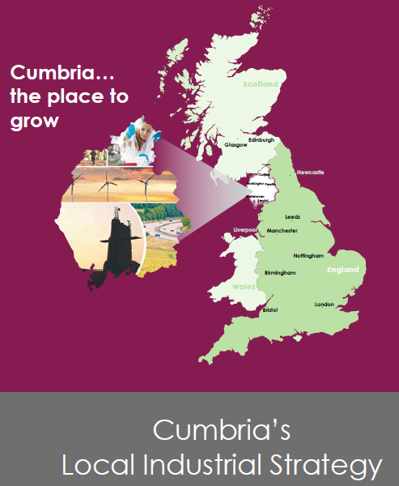
The work carried out
The Engineering and Physics Sciences Research Council (EPSRC) interested in how innovation works and links from businesses to the science base (largely Universities)
EPSRC also interested in lessons from remoter and more rural parts of the UK ie Cumbria
Opportunity for CLEP to explore the issues in more detail; innovation an important theme of the Local Industrial Strategy…
…world leading innovation in many firms and sectors yet there is an innovation “deficit” across the wider economy and a patchy innovation ecosystem…..(LIS, 2019)
CLEP and EPSRC agreed a research brief and work started in February 2021 and was largely completed in November 2021
Phase 1 was an analysis of existing data to identify innovative firms; Phase 2 a survey of businesses with follow-up interviews

Slide 3
Measuring overall levels of innovation in Cumbria
Analysis of the UK Innovation Survey for 2019 and 2017 indicated below average proportions of innovation active firms across the Cumbrian economy (> 10 employees)
North West businesses under perform in terms of access to Innovate UK awards and especially true in Cumbria
Number of collaborations with Cumbria SMEs the EPSRC research base is well below relevant share of manufacturing GVA or total GVA…
…..paradoxically self reported rates of innovation in 2020 Cumbria Business Survey were high
OECD and UK Innovation Survey definition of innovation
1. The introduction of a new or significantly improved product (good or service) or process;
2. Engagement in innovation projects;
3. New and significantly improved forms of organisation, business structures or practices, and marketing concepts or strategies;
4. Investment activities in areas such as internal research and development, training, acquisition of external knowledge or machinery and equipment linked to innovation activities.
Broad and inclusive definition

Slide 4
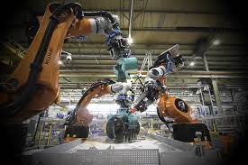
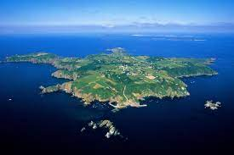
Characterising innovation in Cumbria
Deep but narrow innovation ecosystem around nuclear sector and nuclear engineering
Large firms and institutions
Specialist firms
Part of wider North West nuclear cluster
Largely focussed on de-commissioning
Strong “islands” of innovative firms
Some spillover of technology and expertise into offshore oil and gas, and defence
Strong “islands” of innovative firms
Individuals and smaller firms in isolation
Limited interconnections

Slide 5
Characterising innovative firms in Cumbria
One-off innovators – firms who had introduced and designed new products in the past but having done this have been content to produce and sell the products
Revolutionary innovators – where entirely new products, services or ideas have been produced or are being produced. This is a feature of new tech start-ups of which there are some in Cumbria
Willing but struggling innovators – small or medium sized firms who see the need to innovate to diversify their business and move into new markets but are being held back by a variety of factors (usually time and cost)
Core innovators – where innovation is way of life often because of the nature of their business - constantly having to address complex situations with innovative solutions
Strategic innovators – technological innovation to remain at the cutting edge of their markets, significant R&D/innovation departments and relatively long time horizons on their products and market places

Slide 6
Factors influencing innovation: Drivers
Quality/profit/sales/costs
Needs of existing clients
Diversify to other sectors
Personal satisfaction/ambition
Environmental impacts and other regulatory/ economic drivers
Who firms work with on innovation…
Customers/clients
Suppliers
Parts of a wider group
Consultants/advisors
Universities (largely Northern based)
Local is important for many firms

Slide 7
Factors influencing innovation: Barriers
Management time and or….
….finance/ resources
Knowledge of external support
Commercialisation of ideas

Slide 8
Cumbria: areas for investment and support?
Products and financial support to help get round time barrier (UK SPF?)
Assist Cumbria businesses in awareness of and access national or regional funding for innovation
Innovation funding programme to encourage and support new ideas through and past proof of concept stage
A “technology opportunities map” for the low carbon sectors - to help innovation focus there
Network of “innovators” across Cumbria both businesses and academics (as ambassadors and in practical collaboration)
IT/digital – virtual collaboration network
Masters students into business – tried and tested

